Slide 1

Customer Churn Prediction for Telecommunications Companies
Mentor Name: KARTHIK SIR
TEAM MEMBERS:
Arpita Ashok Sharma
Shatish Shukla
Mr. Shivam Sureshrao Khudsange
Mrs. Bindu S R
Mrs Parinita rahul walavekar
Dhonthu Venkata Kumar
Mr. Pothuraju Pavan Kalyan
DATE : 23/06/2023

Slide 2
Business Problem:
The objective of this project is to develop a predictive model for customer churn in telecommunications companies. The aim is to accurately classify customers as either churned or loyal based on their features, ultimately enabling the implementation of effective strategies to mitigate churn and retain valuable customers.

Slide 3
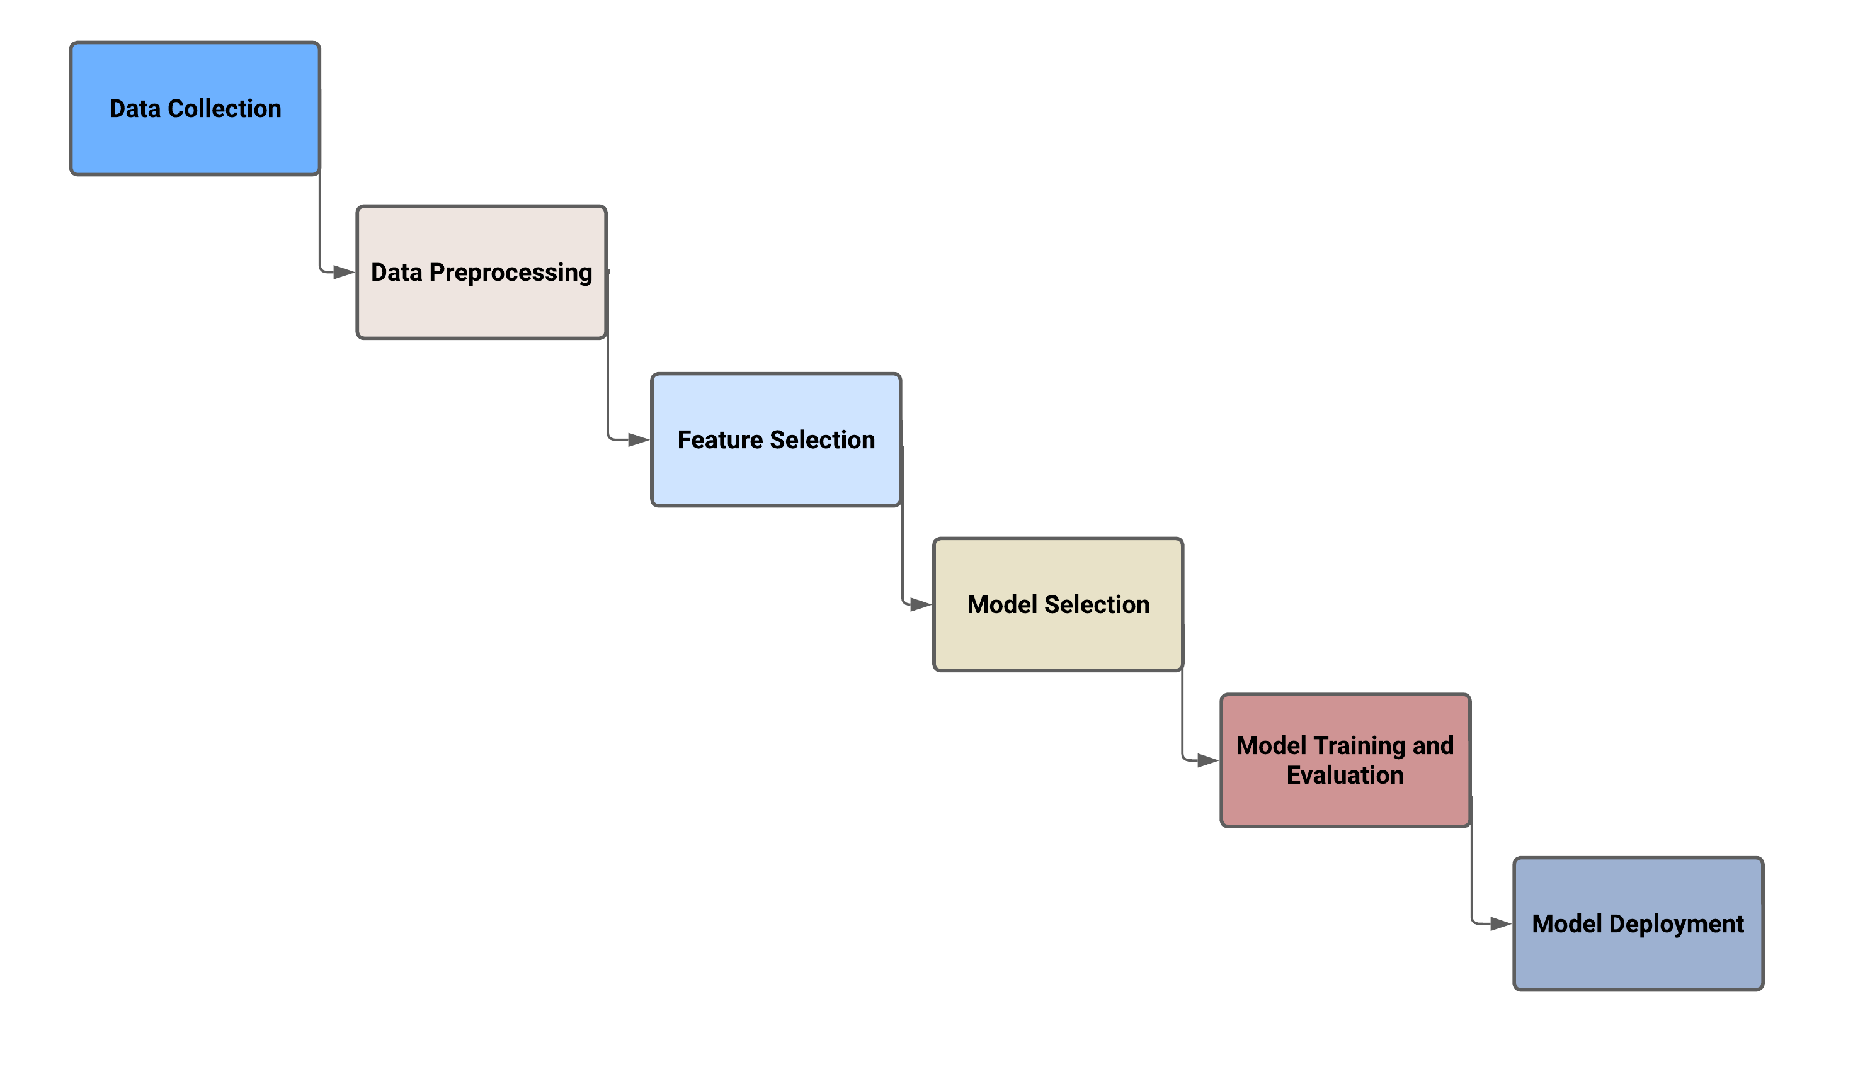
Project Architecture / Project Flow

Slide 4
Exploratory Data Analysis (EDA) and Feature Engineering

Slide 5
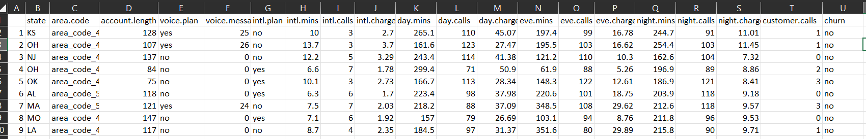
Data set details
The dataset used for this project consists of customer information collected by a telecommunications company. Each row corresponds to a specific client and includes various variables that provide insights into their usage patterns and plan details. Below is a screenshot of the dataset.
The dataset comprises of variables as state, area code, account length, voice plan, voice messages, international plan, international mins, international calls etc.
By analyzing these variables we get to know that, there are total 5000 rows and 21 columns, from which 3 column contain categorical values.

Slide 6
Exploratory Data Analysis (EDA)
While performing EDA, data type of some column such as ‘day.charge’ and ‘eve.mins’ is given object, but it contains float values. So we convert it into float dtype.
We have ‘area.code’ in this ‘area_code_415’ format, for future reference we just extract the area code.
We converted all the categorical values into dummy variables for calculating ‘ A Correlation Matrix’
And more things are done which is shown in following slide.

Slide 7
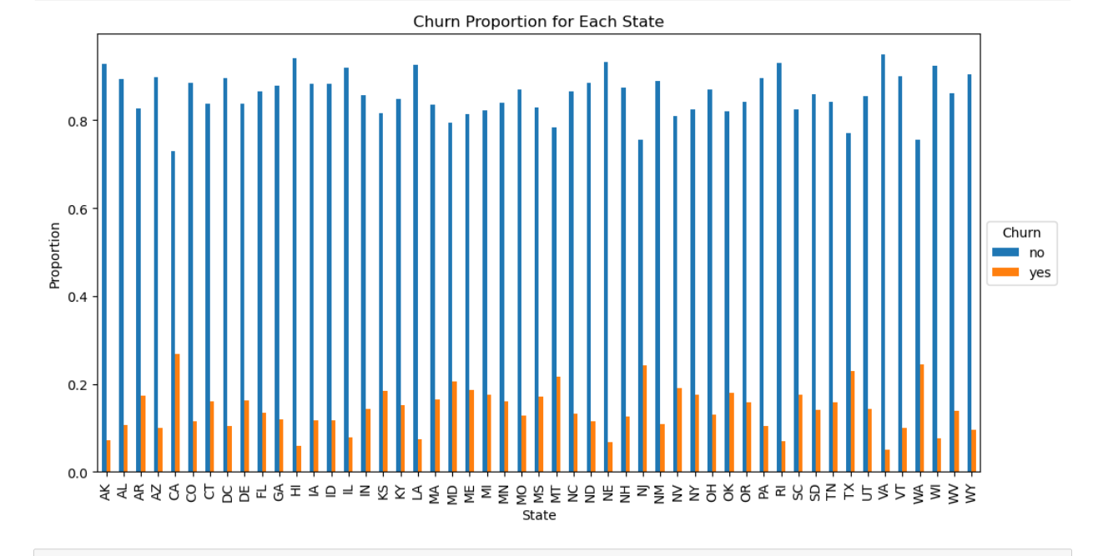
EDA
From this graph we come to know about ‘Churn Proportion for each states’

Slide 8
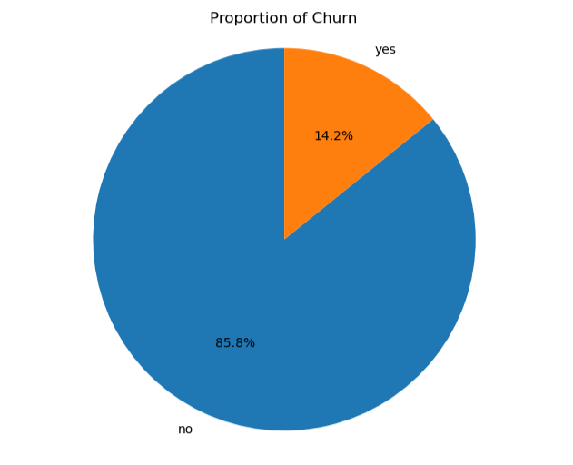
EDA
From the pie chart representing the proportion of churned customers, we can understand the distribution of churned and non-churned customers

Slide 9
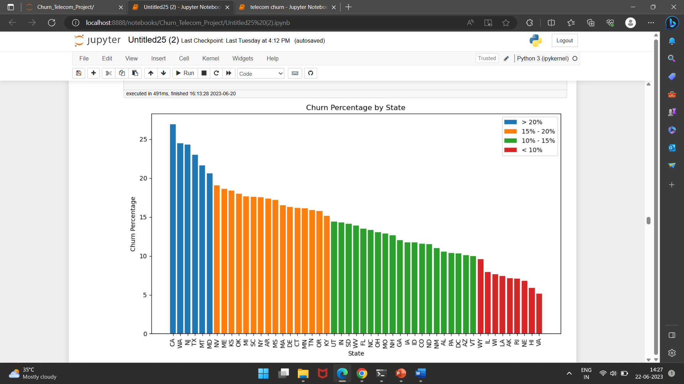
EDA
From this graph we come to know about the states with higher or lower churn percentages. Here we can see customer of state ‘CA’ has highest churn rate and state ‘VA’ has least churn.

Slide 10
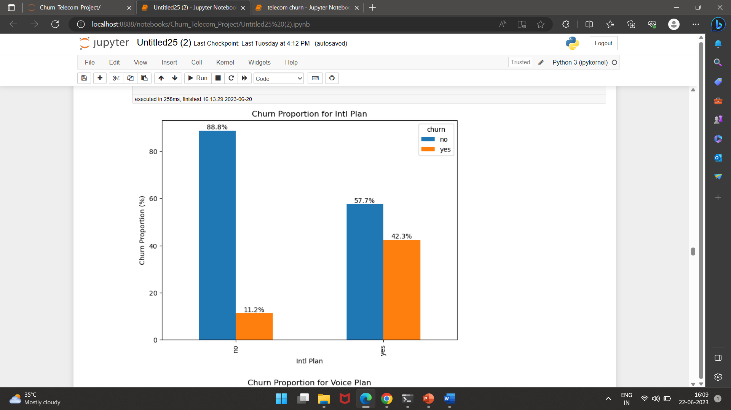
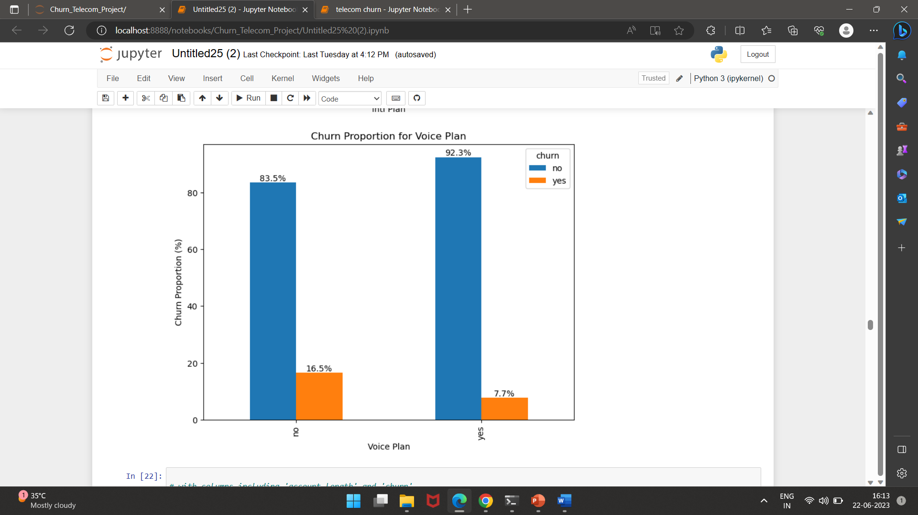
EDA
From the given graphs, we can understand the churn proportions for two important features: 'intl.plan' and 'voice.plan'. These graphs provide insights into how these plan features relate to customer churn.
Customers with an international plan have a higher churn proportion compared to customers without an international plan.
Customers with a voicemail plan have a slightly higher churn proportion compared to customers without a voicemail plan.

Slide 11
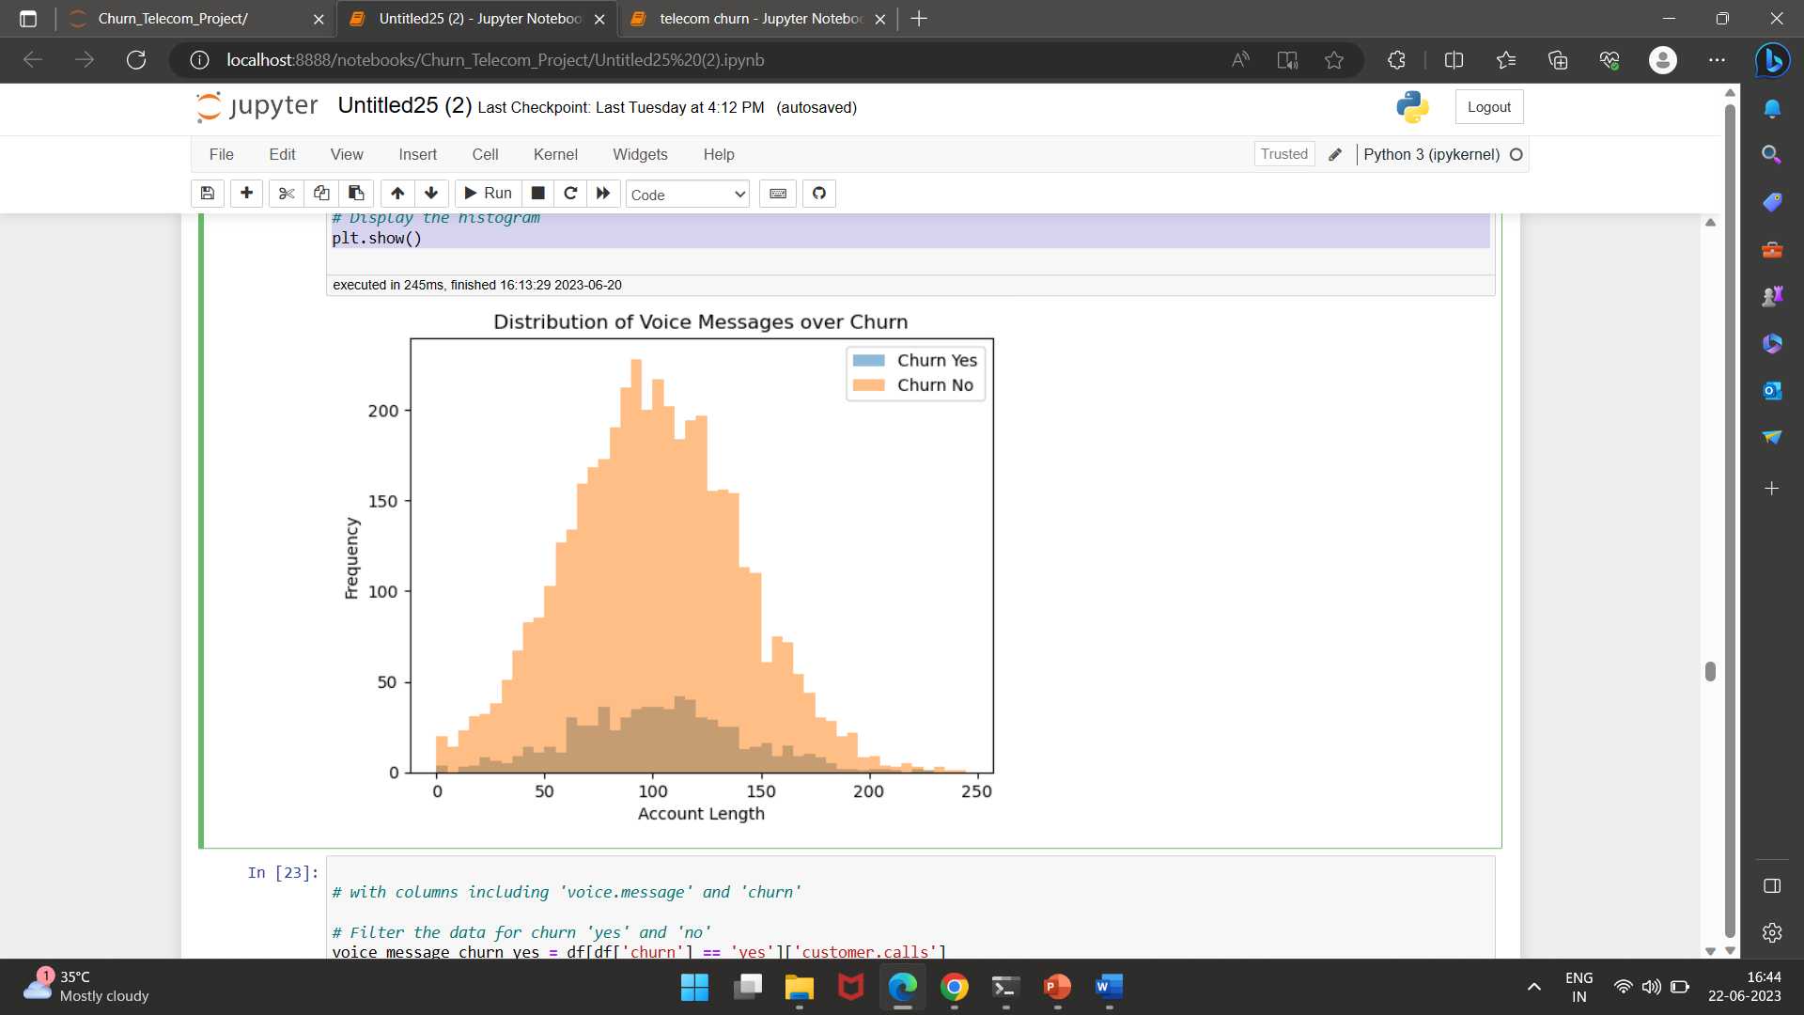
EDA
From the given histogram, we can understand the distribution of account lengths for customers who have churned ('Churn Yes') and customers who have not churned ('Churn No’).
The x-axis represents the account length, which indicates how long the customer has been an active subscriber.
From below graph we can understand customer who have active subscription for long time are less likely to be churn.

Slide 12
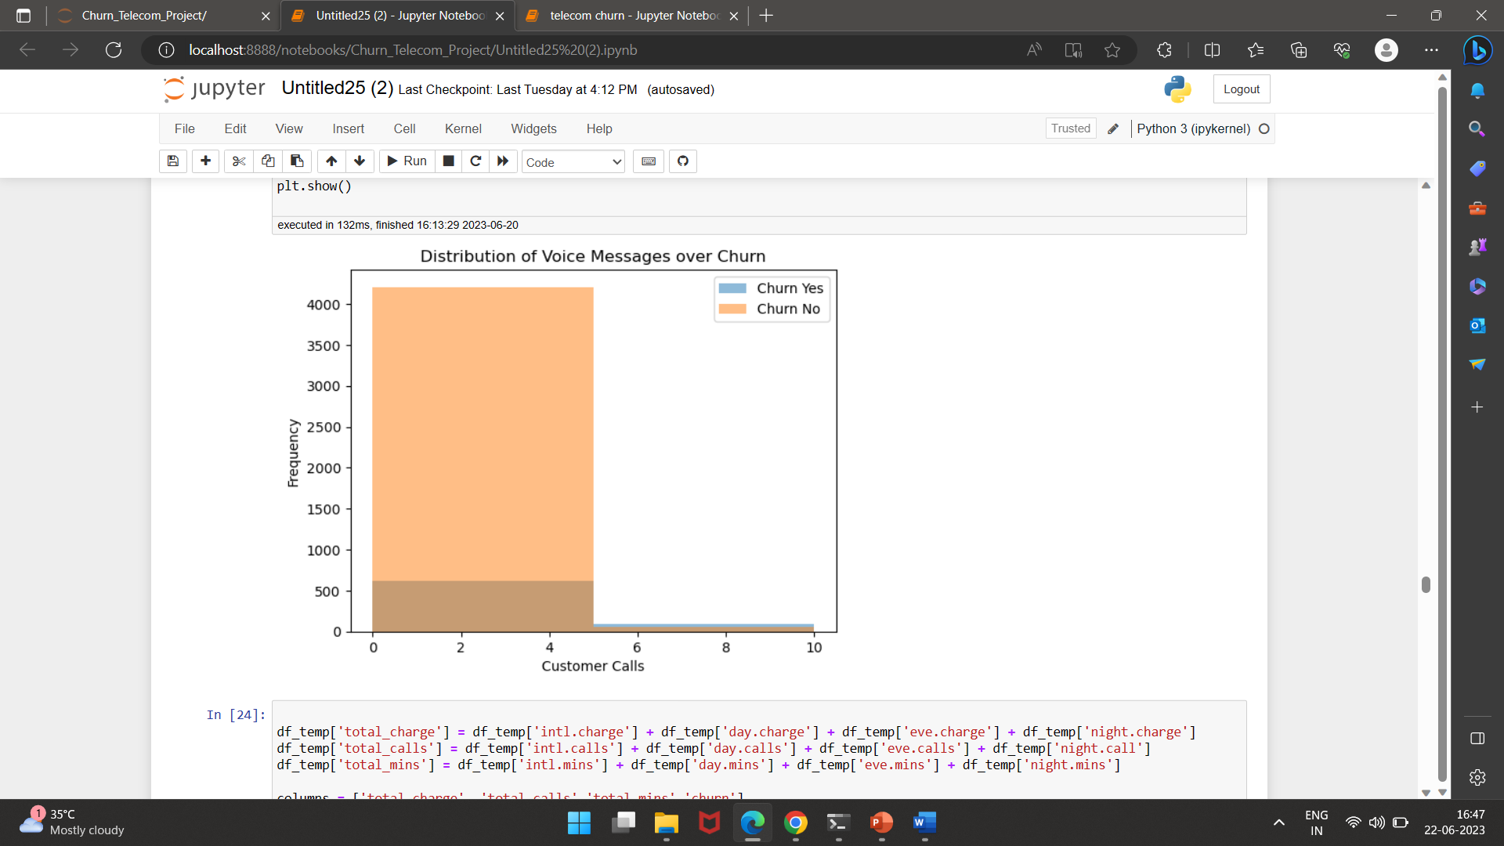
EDA
Here also we can understand customer who have active subscription for long time are less likely to be churn.

Slide 13
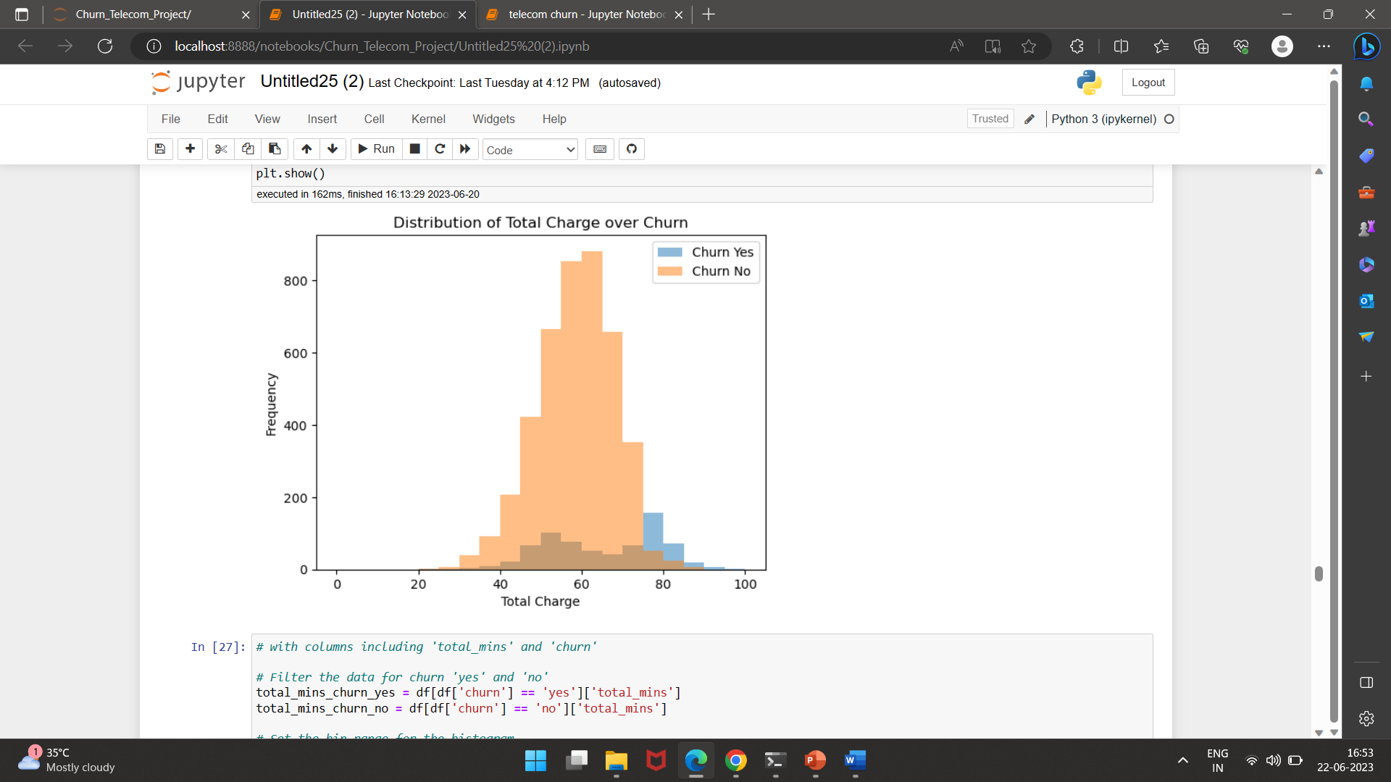
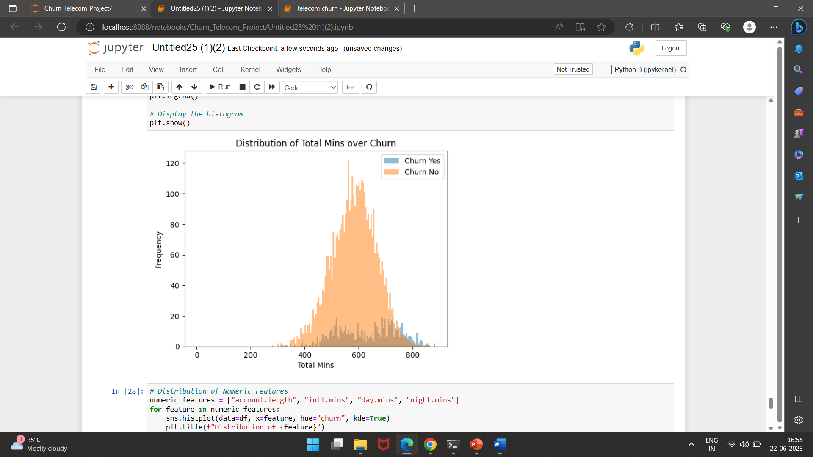
EDA
From the given histogram, we can understand the distribution of total charges for customers who have churned ('Churn Yes') and customers who have not churned ('Churn No’).
Here Total Charge = (df['intl.charge']+ df['day.charge'] + df['eve.charge']+ df['night.charge’])
Same Total Min = (df['intl.mins'] + df['day.mins'] + df['eve.mins'] + df['night.mins’]).
From graph 1 and 2 we can understand that customers who’s total charges and total mins are more they are less likely to be churn.

Slide 14
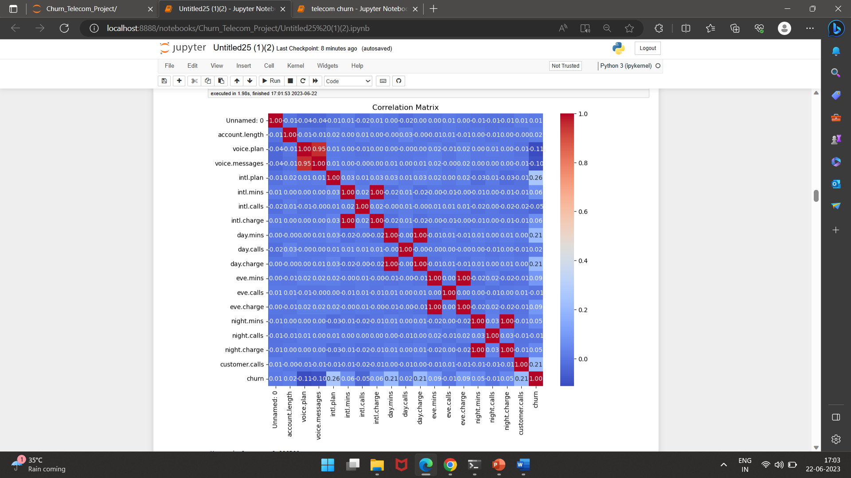
EDA
The 'churn' variable is positively correlated with 'intl.plan', 'day.mins', 'day.charge', and 'customer.calls'. This suggests that customers with international plans, higher daytime minutes, higher daytime charges, and more customer service calls are more likely to churn.
The 'churn' variable is negatively correlated with 'voice.plan' and 'voice.messages'. This indicates that customers with voicemail plans and higher voicemail message counts are less likely to churn.
Other features, such as 'account.length', 'intl.mins', 'eve.mins', 'eve.charge', 'night.mins', 'night.charge', and 'night.calls', show weak or negligible correlations with 'churn'.

Slide 15
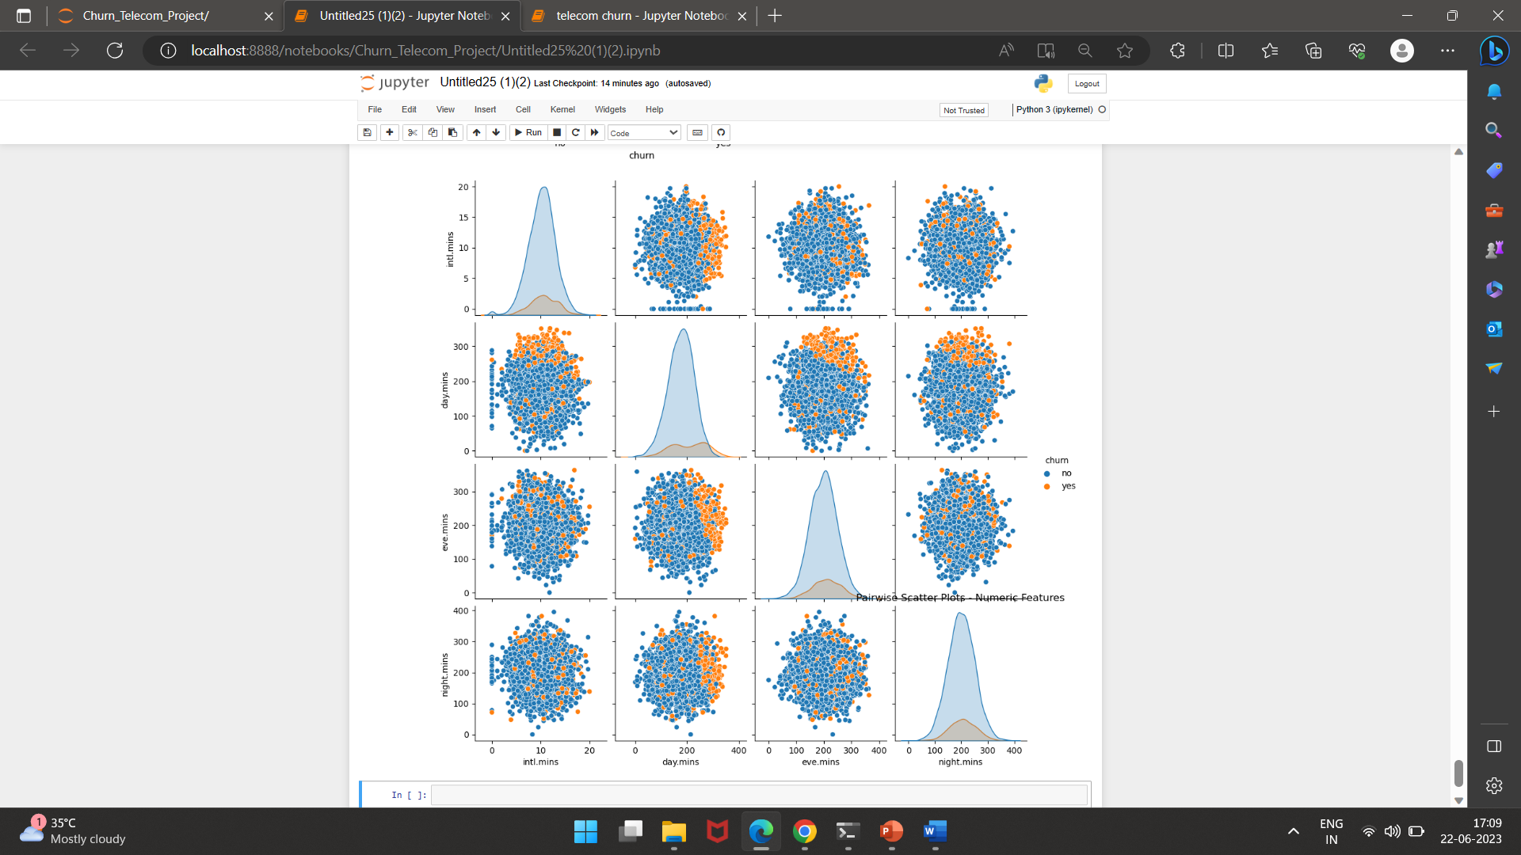
EDA
From the given pairwise scatter plots, we can understand the relationships and patterns between the numeric features (international minutes, daytime minutes, evening minutes, and nighttime minutes) and customer churn.
The scatter plots help visualize the distribution of numeric features and their associations with churn.

Slide 16
Feature Engineering
1.Outliers Detection:
•In the given dataset, in most of the cases, we have Outliers representing no churn customers which can provide valuable information about the extreme cases where customers are highly loyal or have unique characteristics.
•Removing these outliers might result in the loss of important insights into why certain customers are less likely to churn. Understanding such cases can help identify patterns and factors contributing to customer loyalty.
•That’s why we did not remove the outliers.
2. Label encoding:
•We have converted all the categorical features into dummy variable use onehotencoding.
3. Feature Selection:
•With the help of correlation matrix, we can identify columns in a dataset that have a correlation coefficient higher than the specified threshold.
•We have set the threshold = 0.85, which means whichever feature have correlation greater than 0.85, we will drop them.
•This is done for the column with numeric data.
•For columns like ‘area code’ and ‘states’ we have performed chi-square test.
•In summary, based on the chi-square test results, there is no significant relationship between 'area code’ ‘state’ and 'churn' in the given dataset.
•We drop both the columns.
•So in the end, we are left with 15 columns.

Slide 17
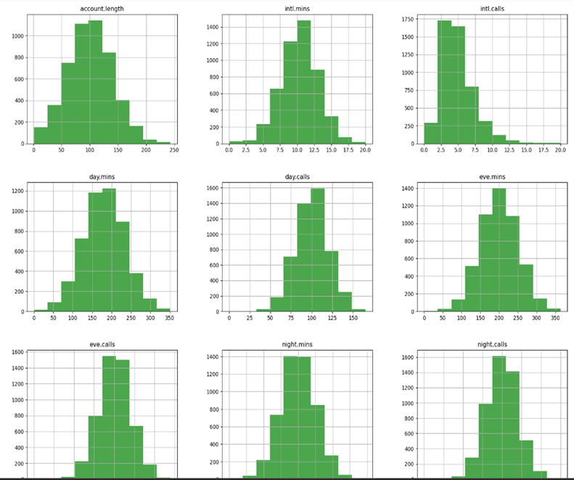
FEATURE ENGINEERING
4. Feature Scaling
Feature scaling is necessary to bring all features to the same scale. If this is not done, then the attention of the algorithm will be attracted to features that include large values.
•Firstly we checked the distribution of the data.
•From the given visualization, we can see that most of the feature are normally distributed. So we standardize the data.
5. Train-Test Split
•We divided our data in 80/20 ratio. 80% for training and 20% for testing.
6. Handled Imbalanced Data:
•Due to target variable imbalance, it's good to over sample the minority class .
•Using SMOTE(Synthetic Minority Over-sampling Technique) an oversampling technique, we balance our target variable.

Slide 18
Model Building

Slide 19
Model Used:
Logistic regression without hyperparameters
Logistic regression with hyperparameters
Decision Tree using 'entropy criterion’
Decision Tree using ‘gini impurity criterion'
Random Forest with default parameters
Random forest With RandomizedSearchCV
KNN
KNN with GridSearchCV
Navie Bayes
XGBoost With RandomizedSearchCV
Support Vector Machine

Slide 20
Model result for 70:30 ratio of dataset​
Model | Accuracy | Recall | Precision | F1 Score | TNR
Logistic Regression without hyperparameters | 76.66% | 75.11% | 0.38 | 0.516 | 76.95%
Logistic Regression with hyperparameters | 76.19% | 75.11% | 0.38 | 0.5 | 76.4%
Decision Tree using 'entropy' criterion | 84.78% | 78.48% | 0.51 | 0.62 | 85.96%
Decision Tree using 'gini impurity' criterion | 85.92% | 76.37% | 0.54 | 0.63 | 87.72%
Random Forest with default parameters | 94.30% | 79.32% | 0.84 | 0.82 | 97.13%
Random Forest with RandomizedSearchCV | 94.5% | 78.06% | 0.86 | 0.82 | 97.61%
KNN | 78.07% | 64.98% | 0.39 | 0.49 | 80.54%
KNN with GridSearchCV | 83.84% | 46.84% | 0.49 | 0.48 | 90.83%
Naive Bayes | 75.45% | 76.37% | 0.37 | 0.5 | 75.37%
XGBoost with RandomizedSearchCV | 94.24% | 78.06% | 0.91 | 0.84 | 98.48%
Support Vector Machine | 88.20% | 62.87% | 0.63 | 0.63 | 92.98%

Slide 21
Model result for 80:20 ratio of dataset​
Model | Accuracy | Recall | Precision | F1 Score | TNR
Logistic Regression without hyperparameters | 76.86% | 75.16% | 0.39 | 0.51 | 77.19%
Logistic Regression with hyperparameters | 76.86% | 75.16% | 0.39 | 0.51 | 77.19%
Decision Tree using 'entropy' criterion | 85.01% | 80.12% | 0.52 | 0.63 | 85.95%
Decision Tree using 'gini impurity' criterion | 87.63% | 76.4% | 0.59 | 0.67 | 89.8%
Random Forest with default parameters | 94.57% | 80.75% | 0.85 | 0.81 | 97.24%
Random Forest with RandomizedSearchCV | 94.37% | 80.12% | 0.84 | 0.82 | 97.12%
KNN | 78.07% | 64.6% | 0.39 | 0.49 | 80.67%
KNN with GridSearchCV | 82.19% | 41.61% | 0.45 | 0.43 | 90.04%
Naive Bayes | 73.14% | 77.02% | 0.35 | 0.48 | 72.39%
XGBoost with RandomizedSearchCV | 95.27% | 80.12% | 0.9 | 0.85 | 98.2%
Support Vector Machine | 88.03% | 64.6% | 0.63 | 0.64 | 92.56%

Slide 22
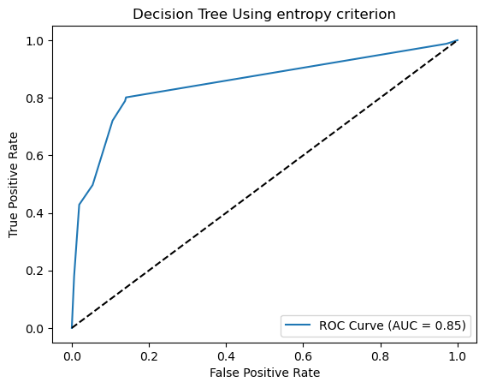
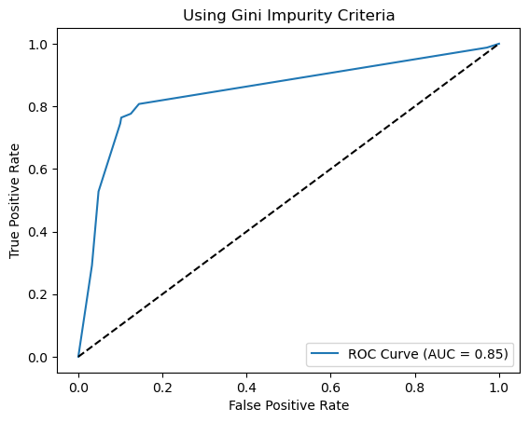
MODEL EVALUATION USING ROC-AUC PLOT

Slide 23
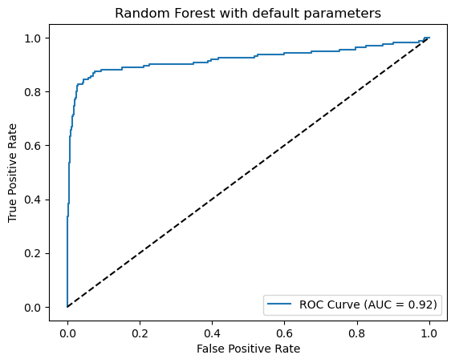
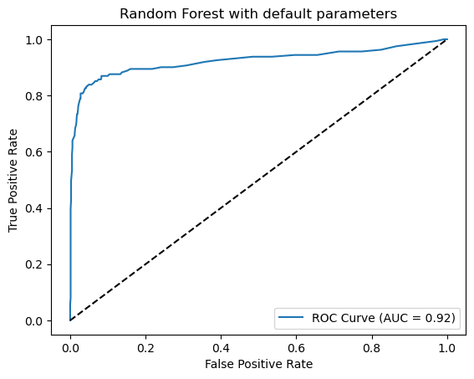

Slide 24
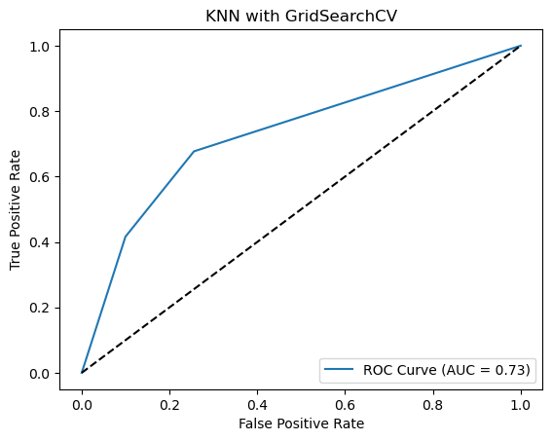
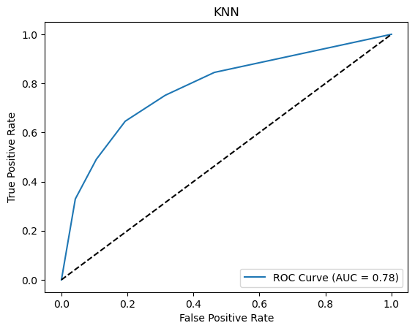

Slide 25
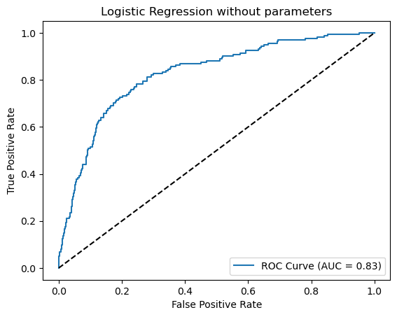
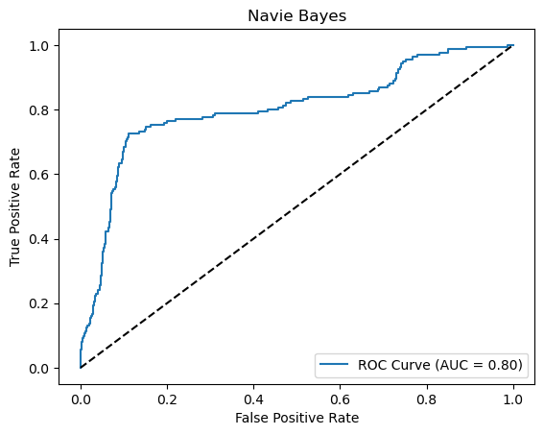

Slide 26
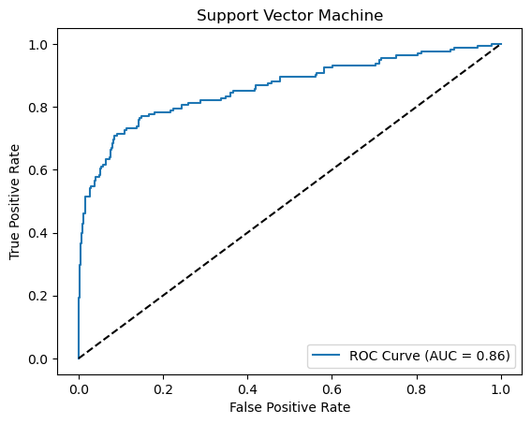
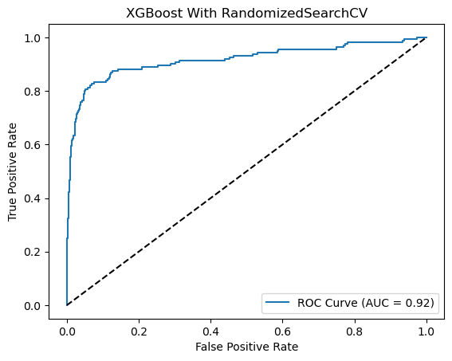

Slide 27
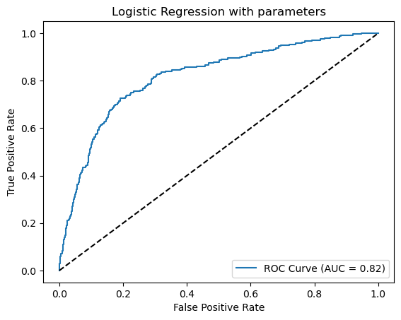
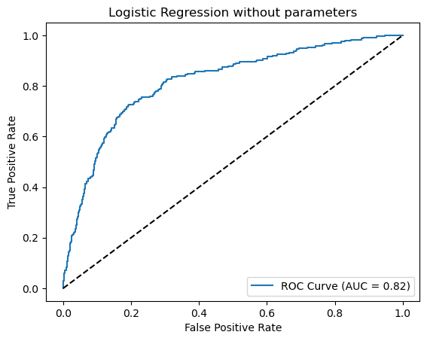

Slide 28
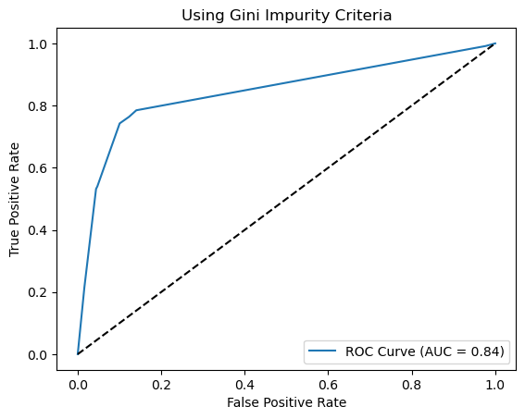
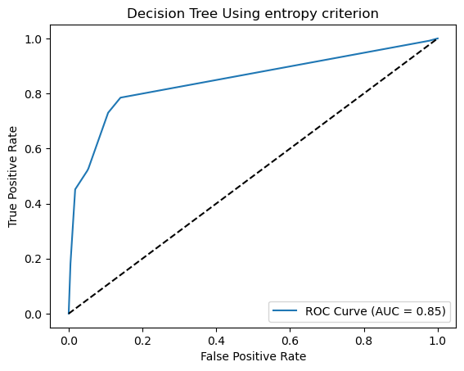

Slide 29
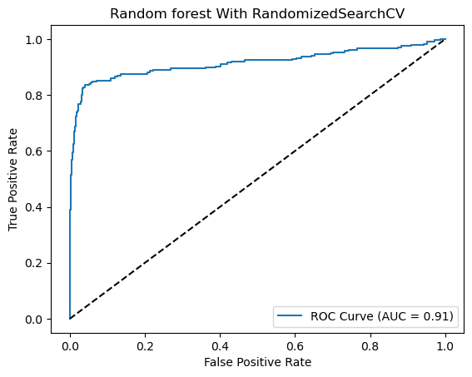
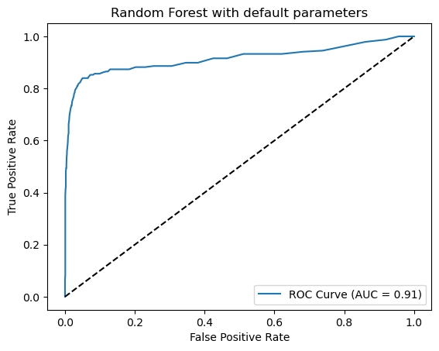

Slide 30
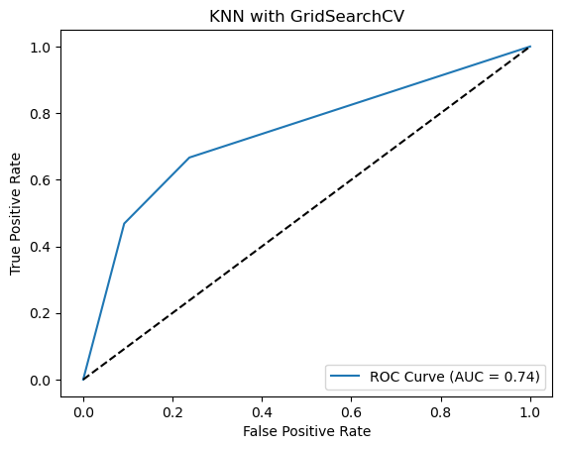
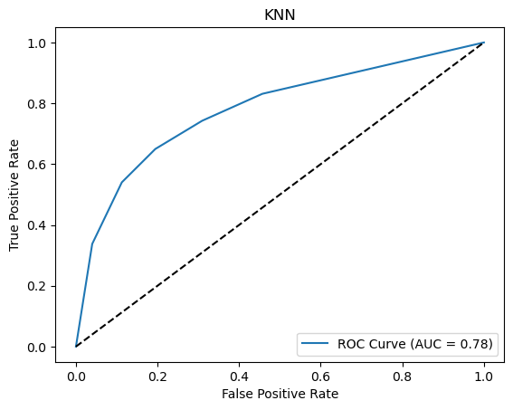

Slide 31
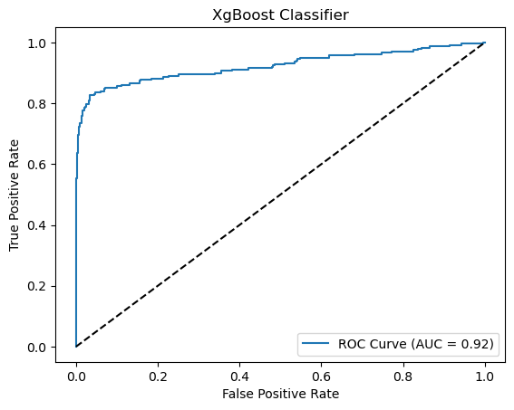
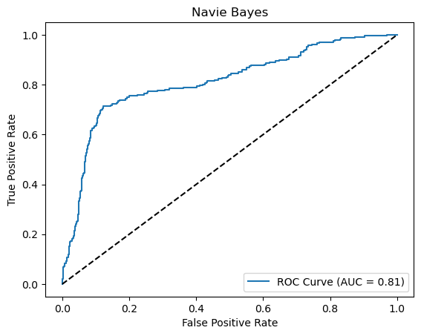

Slide 32
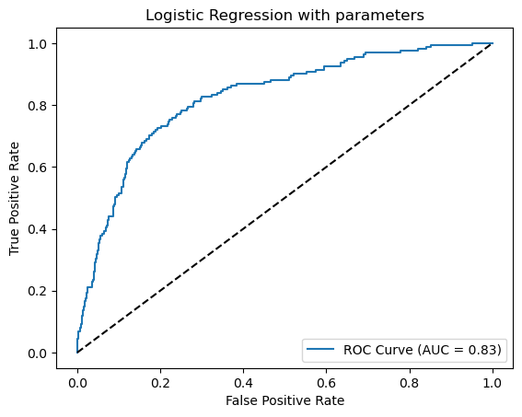
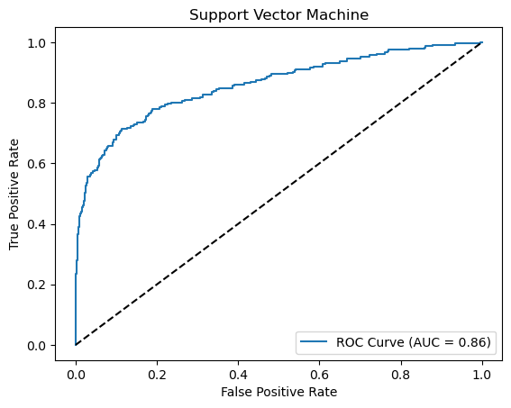

Slide 33
Model Results
For final model, we are using RANDOM FOREST MODEL.
We have deployed our model using Random Forest model.
It is giving Accuracy of 95%.
We have use STREAMLIT for deployment.
We are taking customer information as input.
And Output will be if the customer is likely to STAY OR likely to CHURN.

Slide 34
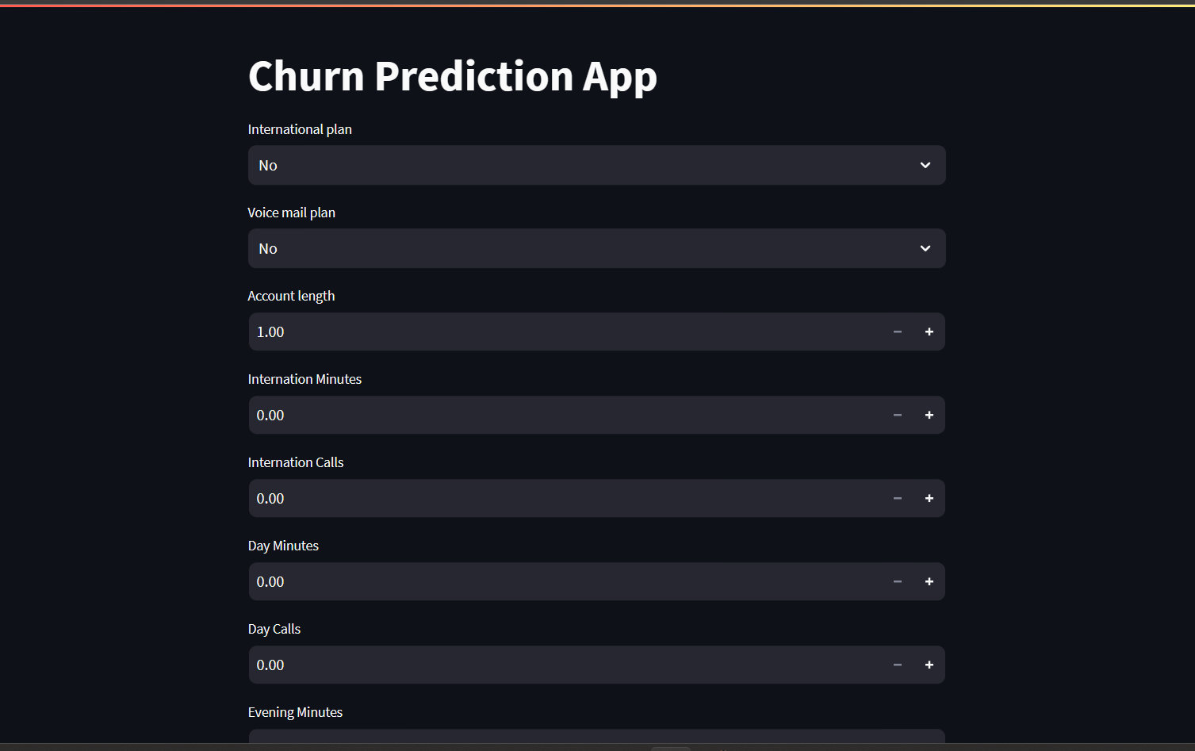
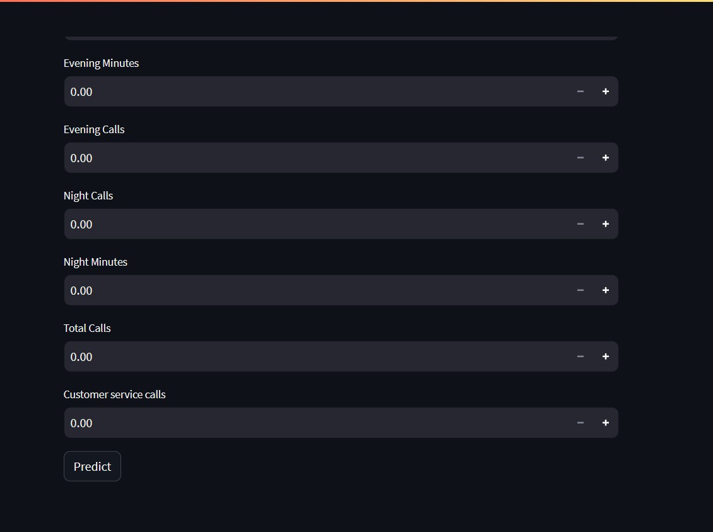
Model Deployment using STREAMLIT

Slide 35
Challenges faced?
Data Quality and Completeness
Imbalanced Data
Feature Selection and Engineering
Model Selection and Tuning
Overfitting and Model Evaluation

Slide 36
Thank you

